Slide 1
Prototype
User experience
Bryan Christian – 2101631891
Chandra kurniawan – 2101637270
Riccosan - 2101632572

Slide 2
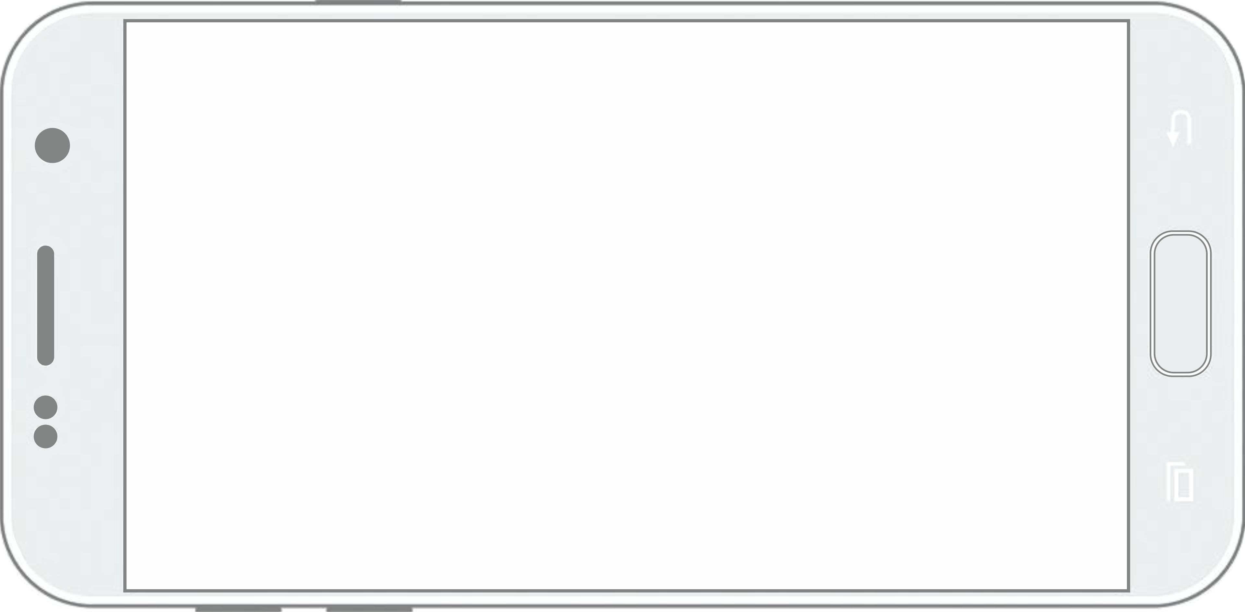

Splash Screen

Slide 3

Loading Screen
2.1225.56488.265
Loading…

Slide 4

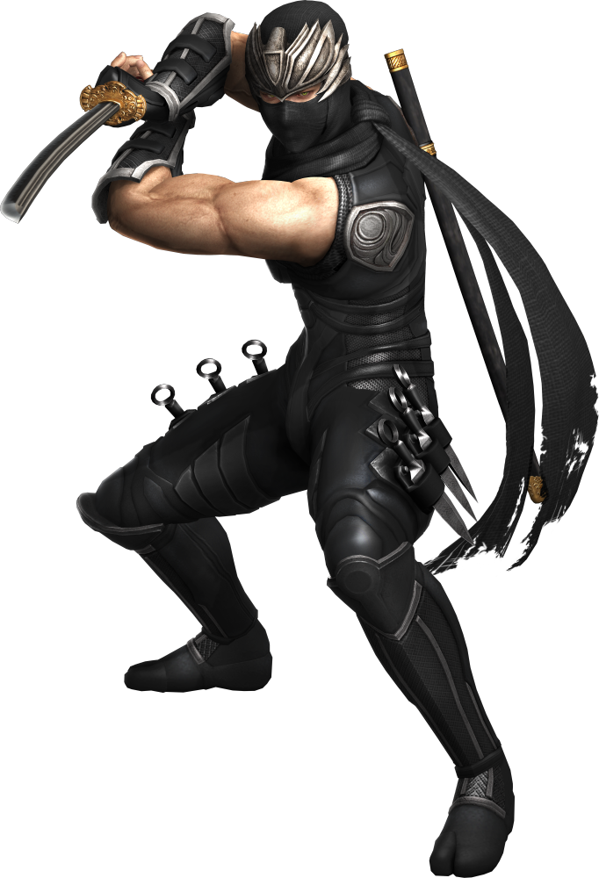
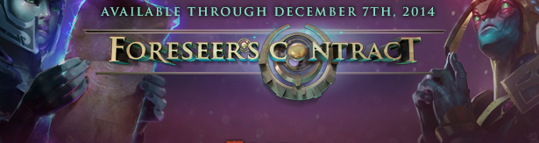

Login / Register Screen
Username :
Password :
Forgot Password / Register ?

Slide 5

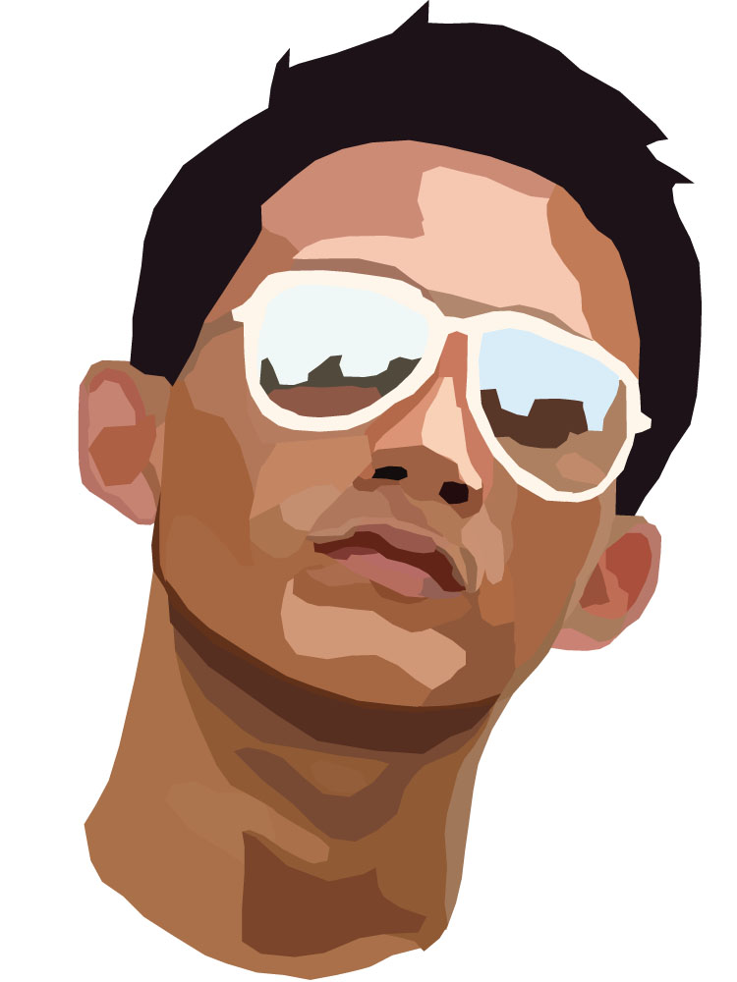
Main Menu
Shop
RANK
Option
Player Name
326154.12223567
Achievement
Event
Tutorial
Emblem
Option match
EXIT GAME
Quick match
Inventory
Mail
Moving Notification….

Slide 6


Achievement - All
Achievement
All
Un - Achieved
Achievement 1
Achievement 2
Achievement 3
Achievement 4
$100
5500 exp
1000 exp
$100
Achieved
Achieved
Achieved
Achieved

Slide 7
Achievement – Un-achieved
Achievement
All
Un - Achieved
Achievement 1
Achievement 2
Achievement 3
Achievement 4
$100
5500 exp
1000 exp
$100
Achieved
Achieved
Achieved
Achieved

Slide 8

Events
event
Gigantic War
Event 2
Event 3
Event 4
GIGANTIC WAR
Event detail….

Slide 9

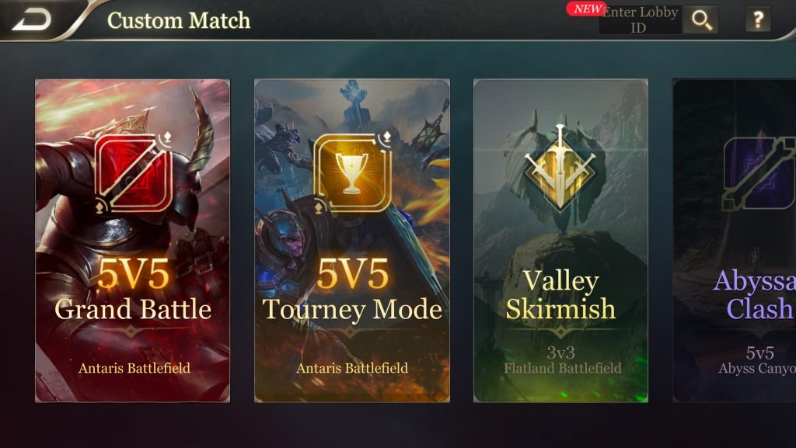
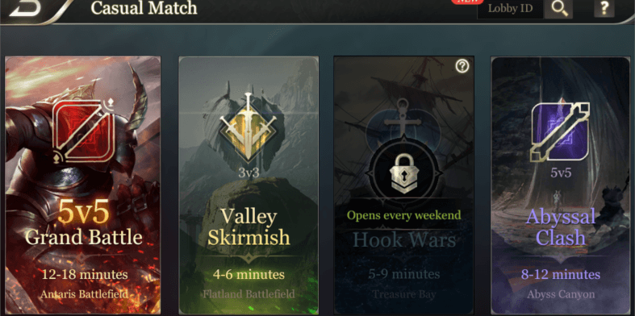
Match Option
Match Option
Begin !!!

Slide 10
Tutorial
05:44 am
TUTORIAL
Versus AI
Versus AI
Versus AI
Begin !!!

Slide 11
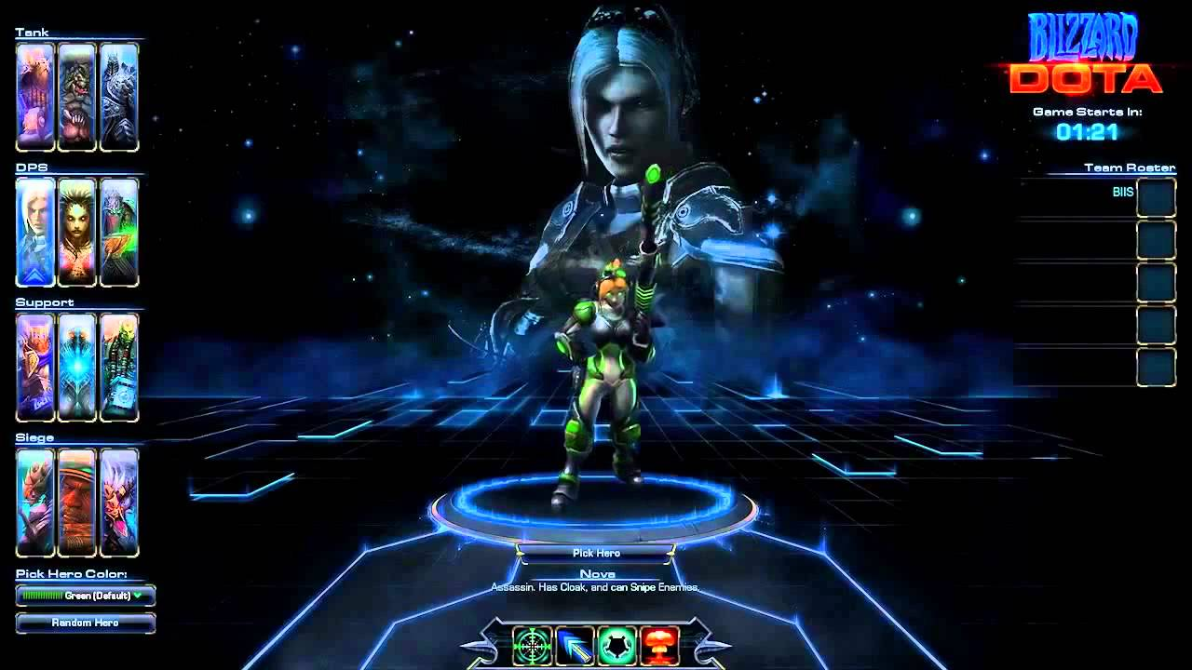
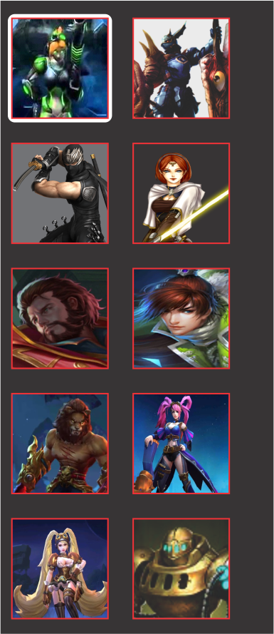

Character Select
00 : 59
Fight !!!

Slide 12
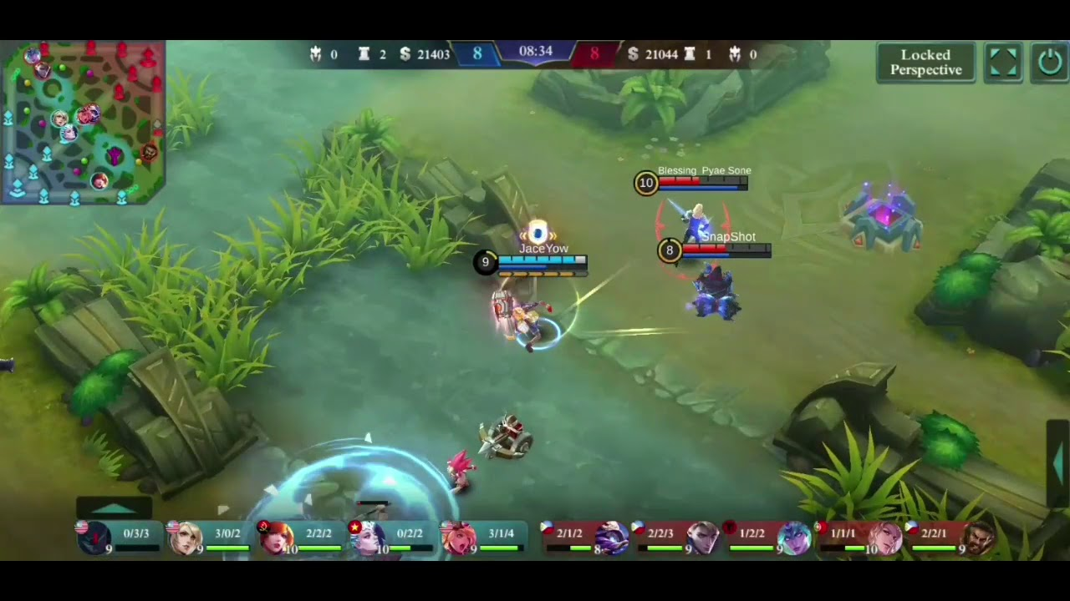
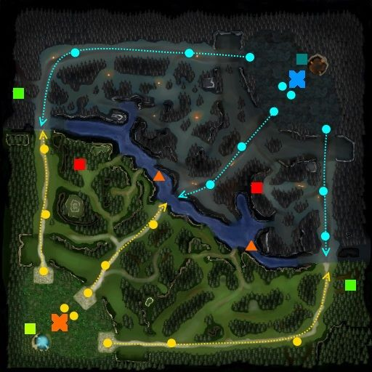

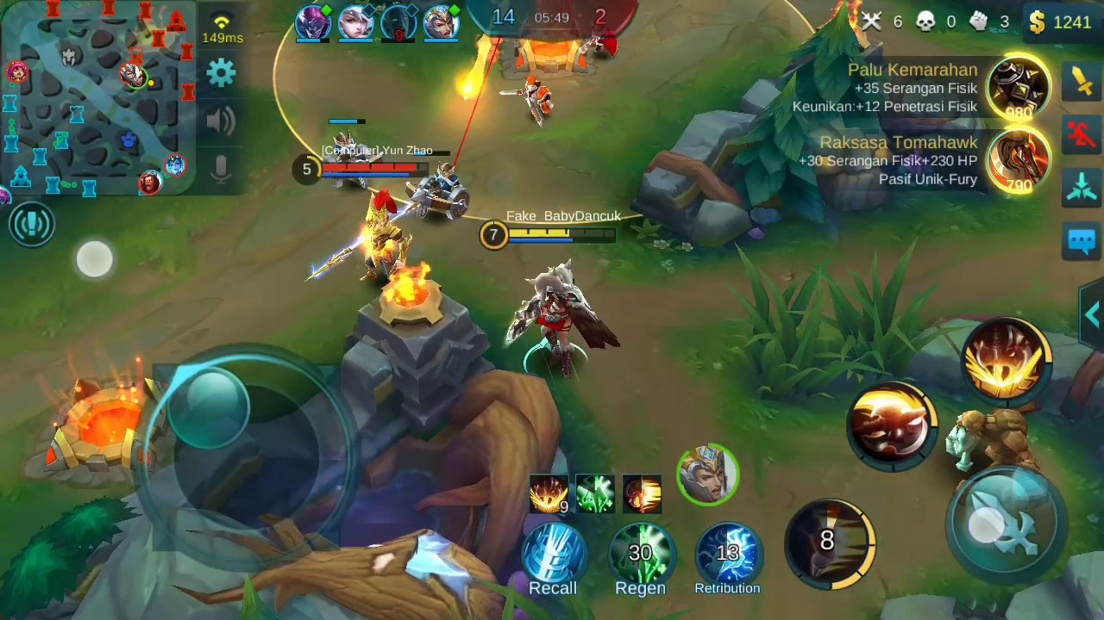




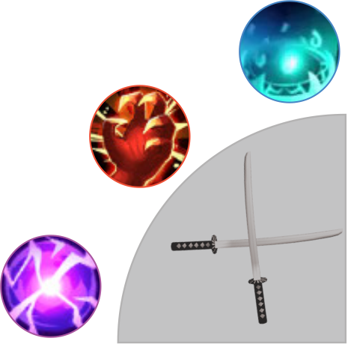


Gameplay
1
00 : 59
0
$ 764
!

Slide 13
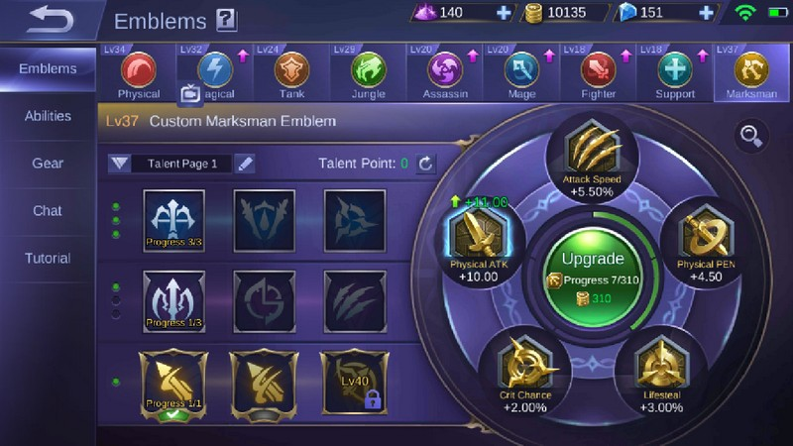
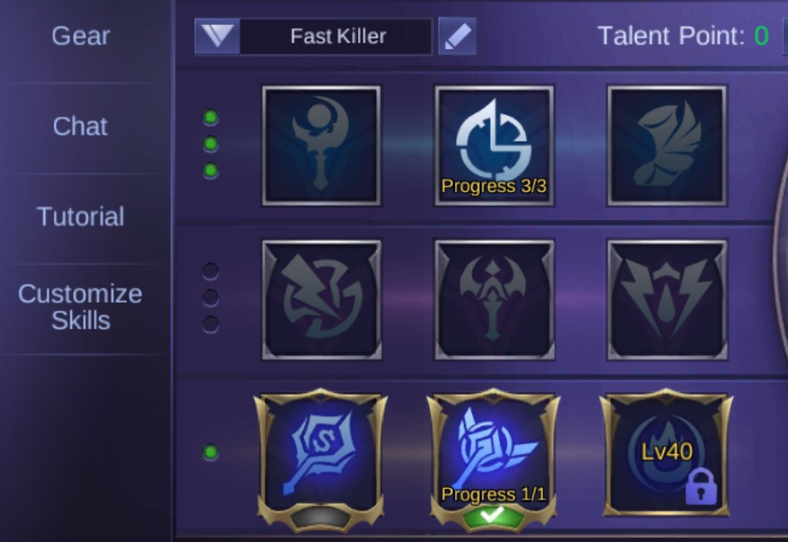
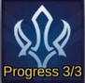
Emblem
Emblem
Selected Emblem Details
Equipped
Equip
Equip
Emblem Set
×
×
×
Remove All
Apply

Slide 14
World Ranks – Win’s Rate
WORLD RANKS
Win’s Rate
No. Profile Name Win’s Rate
Alfa
Win’s Rate
75.60%
#1
Play time
Bravo
Win’s Rate
73.20%
Achievement
#2
Charlie
Win’s Rate
69.45%
#3

Slide 15
World Ranks – Play Time
WORLD RANKS
Win’s Rate
No. Profile Name Total Time
Alfa
1452 hours
#1
Play time
Bravo
1420 hours
Achievement
#2
Charlie
1397 hours
#3

Slide 16
World Ranks – Achievement
WORLD RANKS
Win’s Rate
No. Profile Name Total Achievement
Alfa
71 pieces
#1
Play time
Bravo
55 pieces
Achievement
#2
Charlie
53 pieces
#3

Slide 17
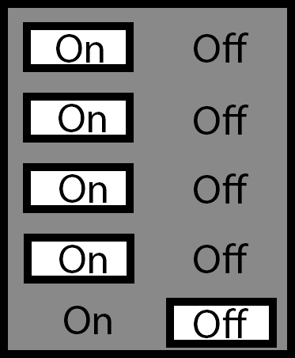
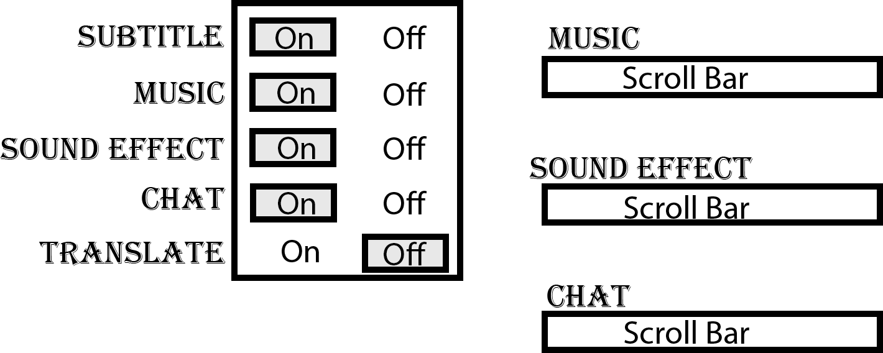
Option - Settings
Option
05:44 am
Settings
Gameplay
Volume
Control
Graphics

Slide 18
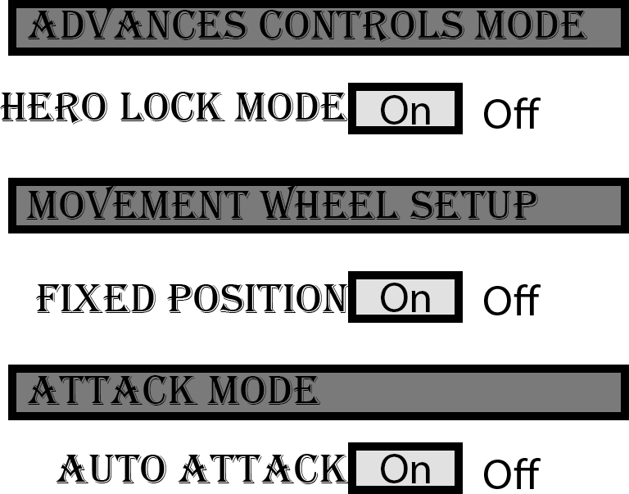
Option - Control
Option
05:44 am
Settings
Control
Graphics

Slide 19
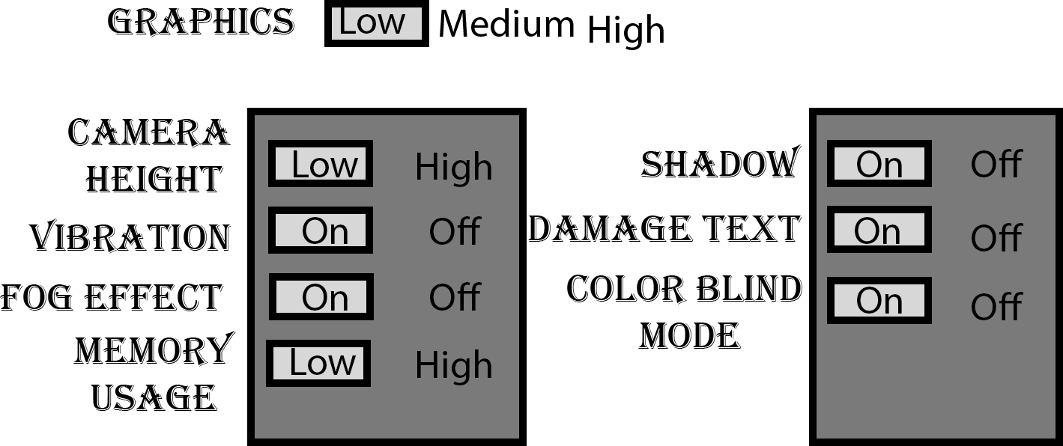
Option - Graphics
Option
05:44 am
Settings
Control
Graphics

Slide 20

Profile - Identity
Profile
Identity
Statistic
History
Since :
20 Feb 2018
E – mail :
playeremail@mail.com
Name :
Unknown
Account Settings
Nickname

Slide 21
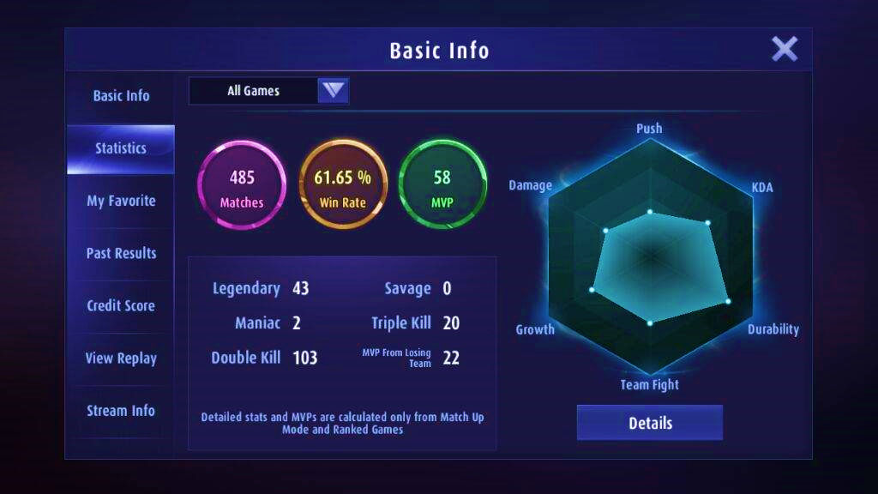
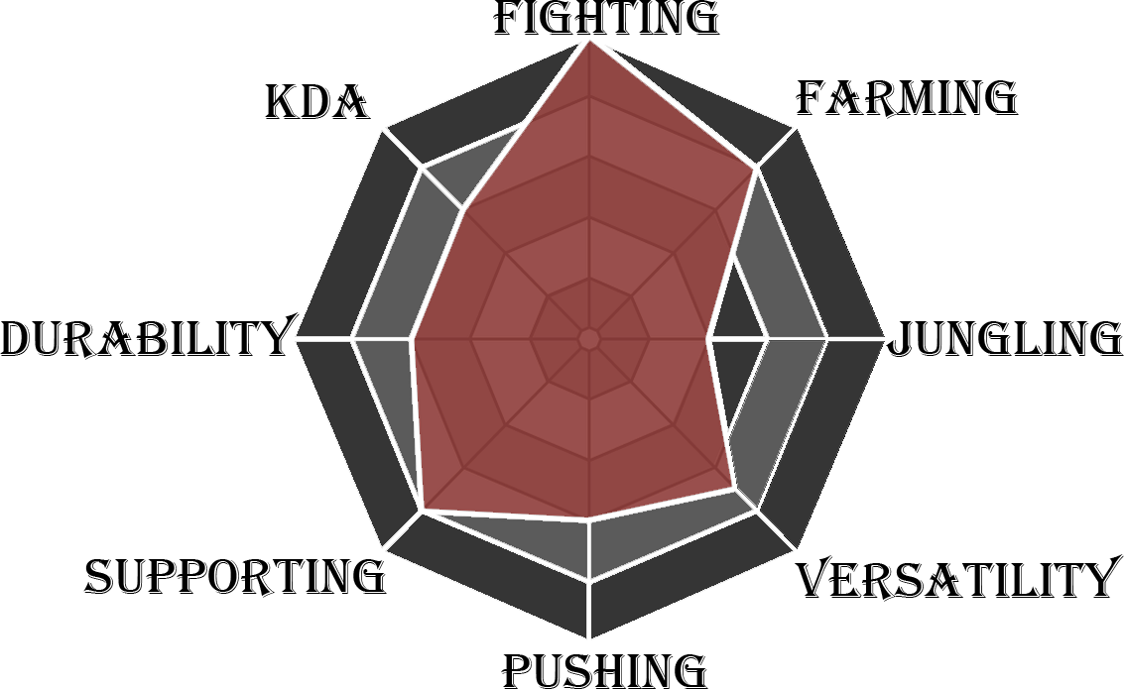
Profile - Statistic
Profile
Identity
Matches
5,179
Win’s Rate
75.60%
K/D
49.2%
Statistic
History
Account Settings

Slide 22
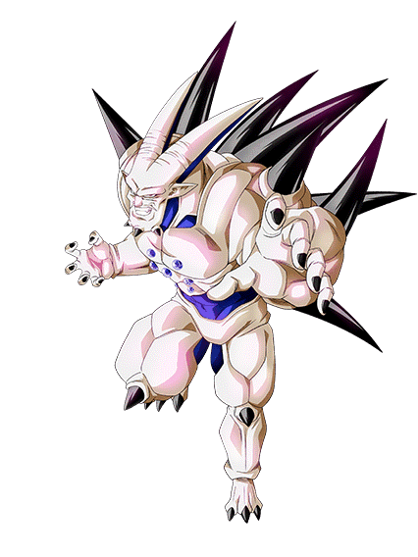
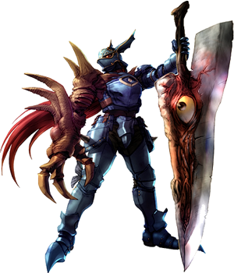
Profile - History
Profile
Identity
Win
Lose
Win
Statistic
Lvl 17
Lvl 10
Lvl 25
History
Account Settings

Slide 23



Profile - Account Settings
playeremail@mail.com
Profile
Identity
326154.12223567
Statistic
Connect To:
History
FAQ
Privacy Policy
Account Settings
Player Data

Slide 24
Mail - Inbox
MAIL
Inbox
Notice
No mail
Reminder
Gifts

Slide 25
Mail - Notice
Mail
Inbox
Notice
No NOTIFICATION
Reminder
Gifts

Slide 26
Mail - Reminder
REMINDER
Inbox
Notice
No EVENT
Reminder
Gifts

Slide 27
Mail - Gifts
GIFTS
Inbox
“Gift name”
Claim
Notice
“Gift name”
Claim
Reminder
“Gift name”
Claim
Gifts

Slide 28
Inventory - Character
Inventory
Gyna Freeze
character
skin
iTEM
oTHERS
Character Detail
Detail….

Slide 29
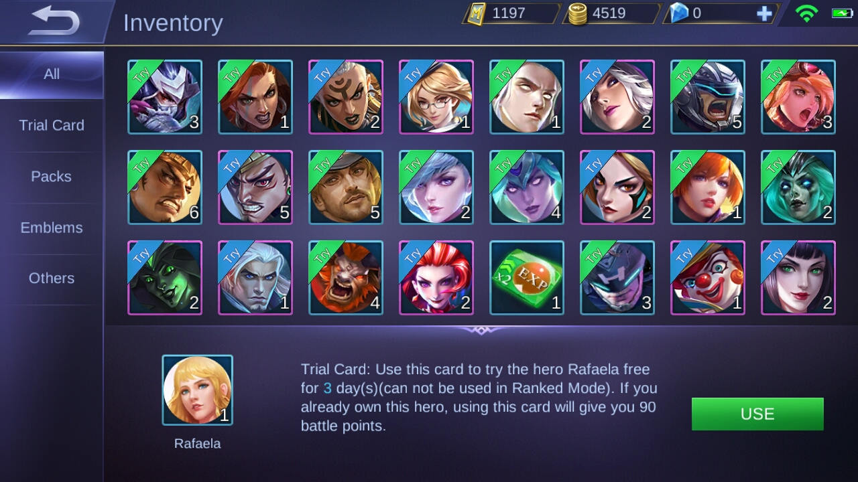
Inventory - Skin
Inventory
character
skin
iTEM
oTHERS
Selected Skin Name
Selected Item Detail…

Slide 30
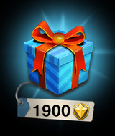


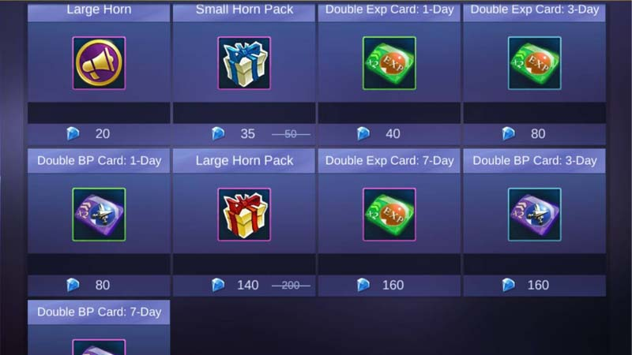


Inventory - Item
Inventory
character
skin
iTEM
oTHERS
Selected Item Name
Detail of the skin that selected
Amount : 5

Slide 31
Inventory - Others
NO ITEM
Inventory
character
skin
iTEM
oTHERS
Selected Item Name
Detail of the skin that selected
Amount : 0

Slide 32
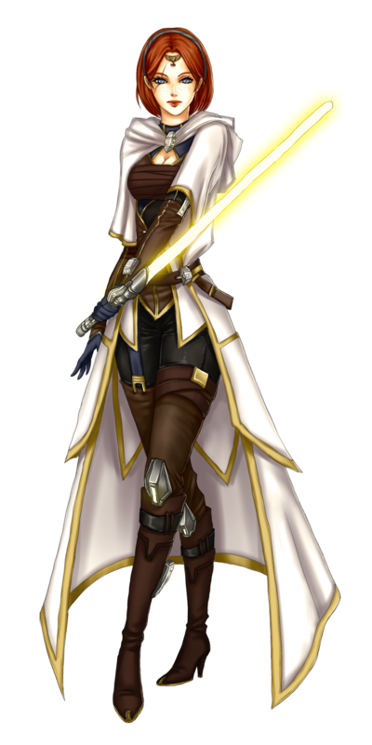
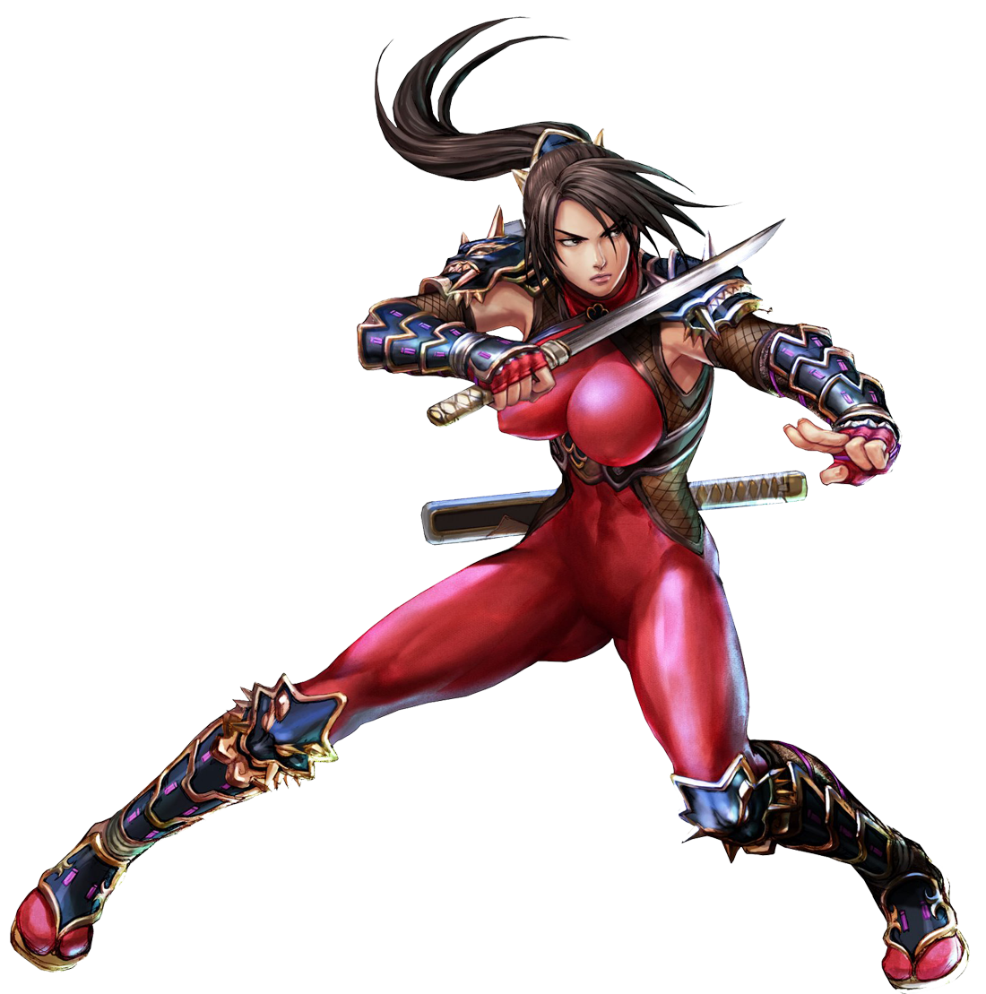
Shop - Character
Shop
$112
Character
Character’s Type
Detail
Selected Character
Skin
Emblem
$ 9.99
$ 9.99
Jedi Scholar
Taki
Item Raffle
Buy
Buy

Slide 33
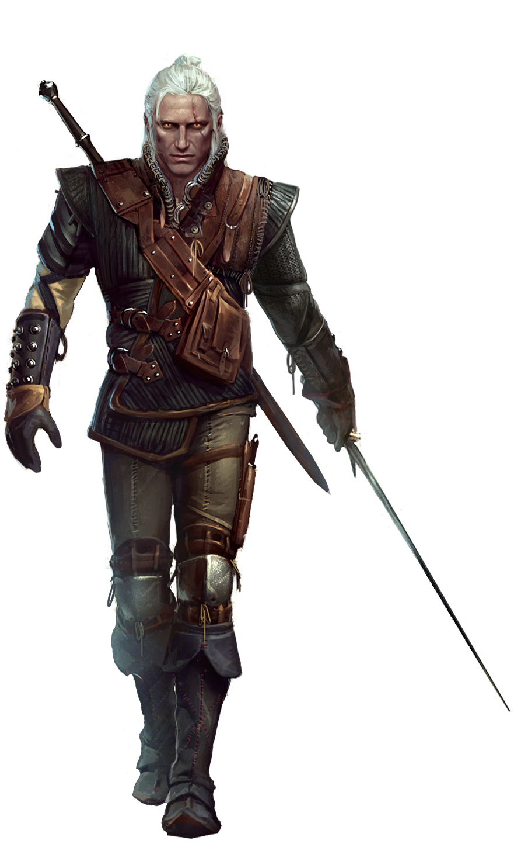
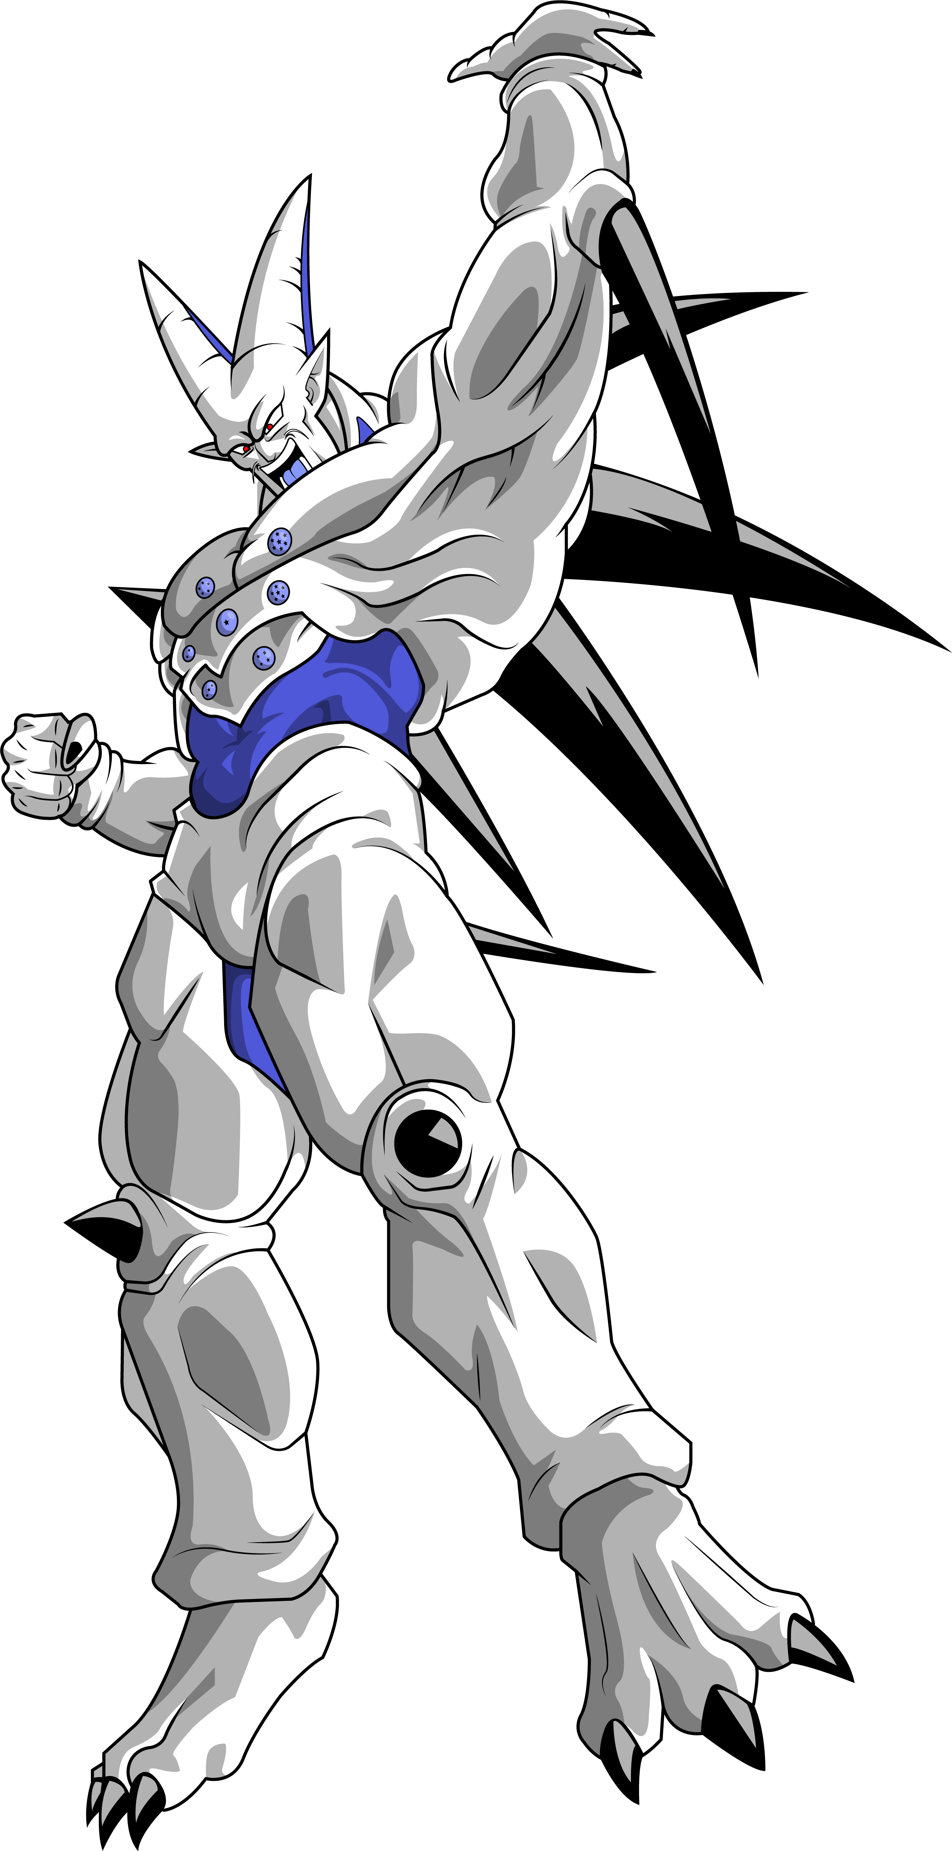
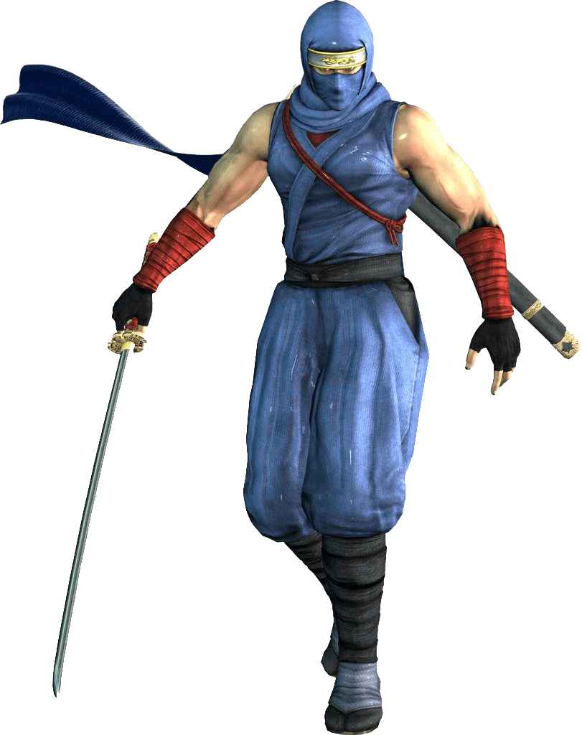
Shop – Skin
Shop
$112
Character
Skin
Skin a
Skin b
Skin c
Emblem
$4.99
$4.99
$4.99
Buy
Buy
Buy
Item Raffle

Slide 34
Shop – Emblem
Shop
$112
Character
Skin
Arrow emblem
Time emblem
Claw emblem
Emblem
$4.99
$4.99
$4.99
Buy
Buy
Buy
Item Raffle

Slide 35
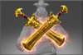
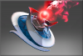
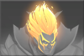

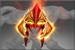
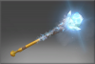
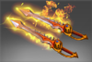
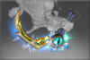
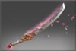
Shop – Item Raffle
Shop
$112
Character
Chances
10
Skin
Emblem
Item Raffle
Buy Chance
Spin

Slide 36

Exit Game
Are you sure?
Yes
No

